Slide 1






Slide 2
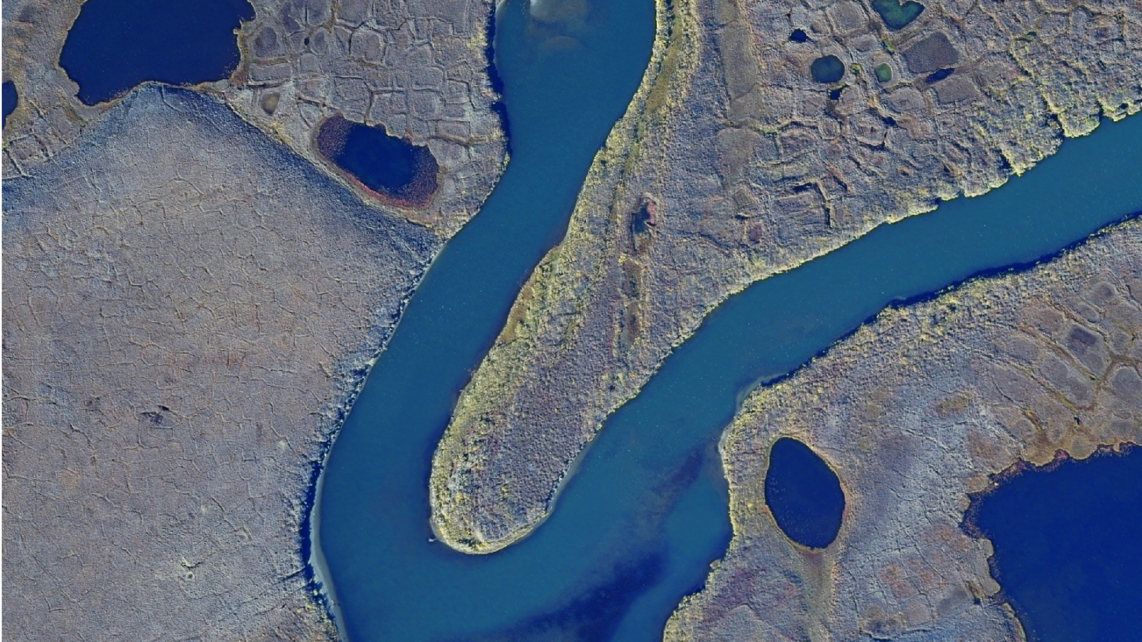
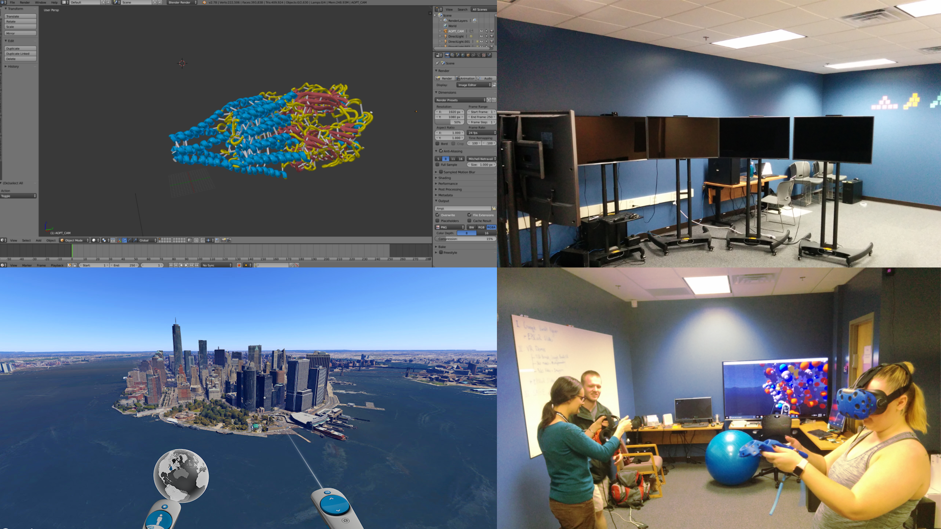
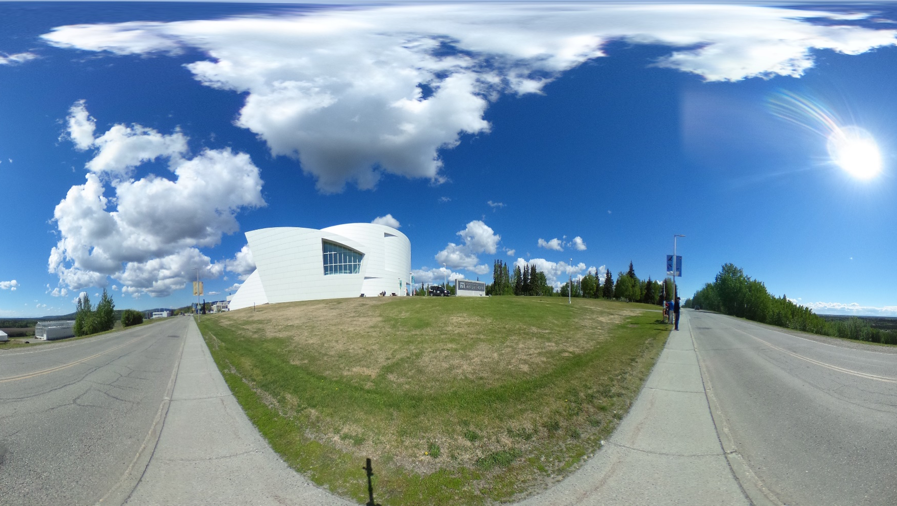
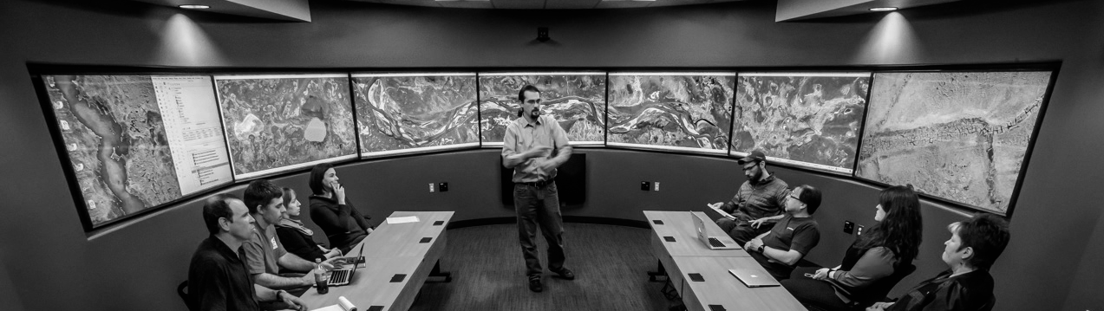

DTN
360° Video
and
Imagery
DEVELOPMENT SPACE
AND
VIRTUAL REALITY
GEO-SPATIAL
USE CASES
SAGE2
BASICS

Slide 3
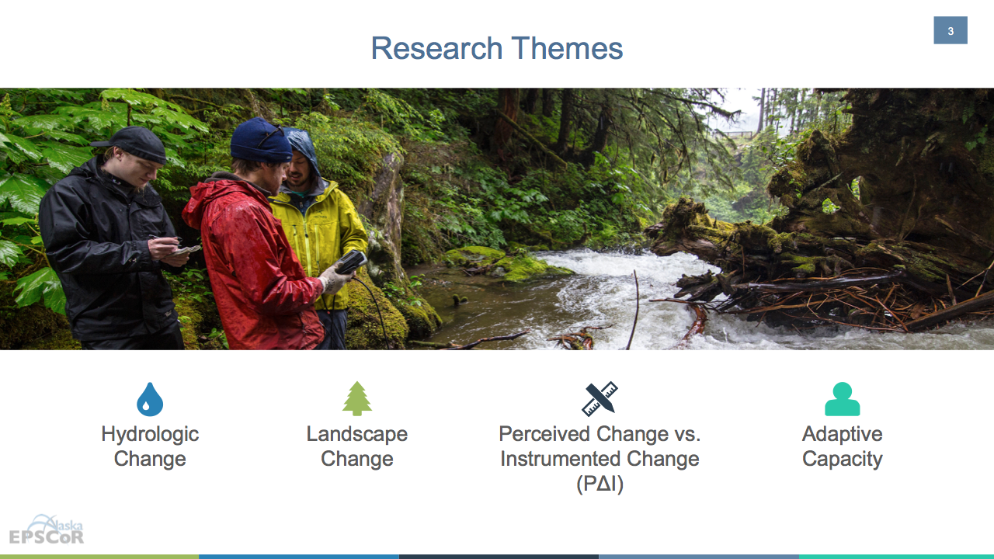
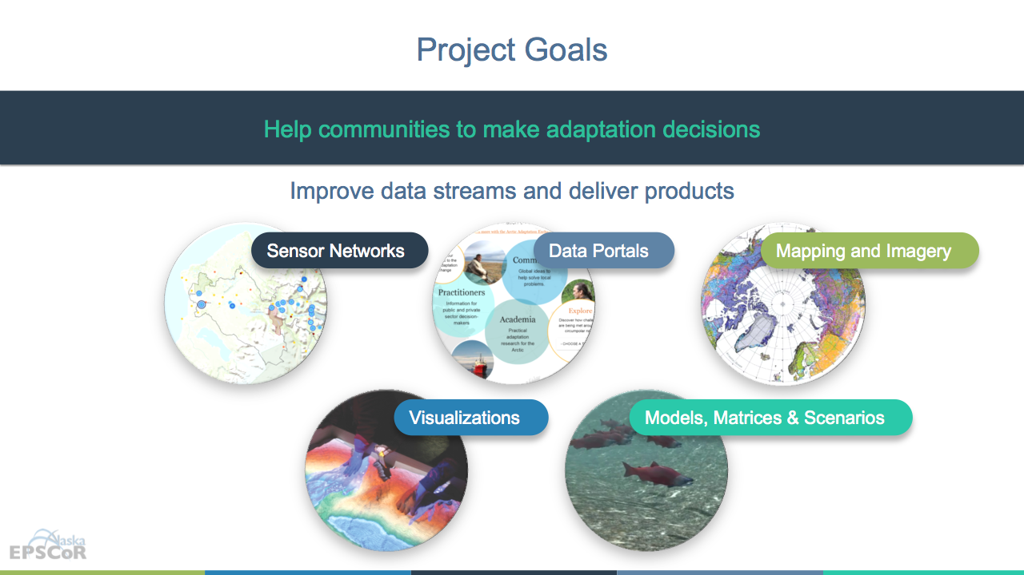


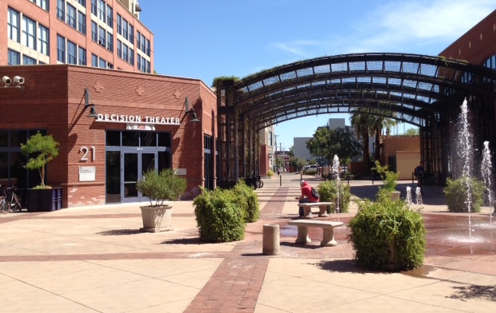
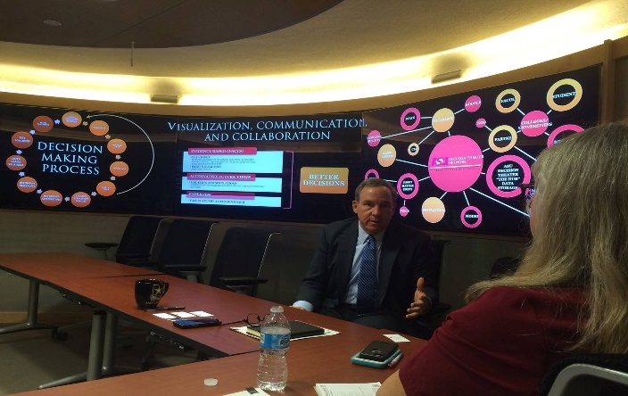



Decision Theater Network
Data to Decisions
People
desirability
Alaska ACE: Adapting to Changing Environments
The mission of Decision Theater North is to provide a cutting-edge, immersive, visual environment to facilitate dialogue and decision-making by agencies, industry, communities and academia.
Data
reliability
Solutions
sustainability
Decision Theater North is a gathering place for people to discuss issues that span the boundaries of location, time, and discipline.
ASU Decision Theater
Arizona State University
Tempe, AZ
ASU Decision Theater
McCain Institute
Washington, D.C.

Slide 5
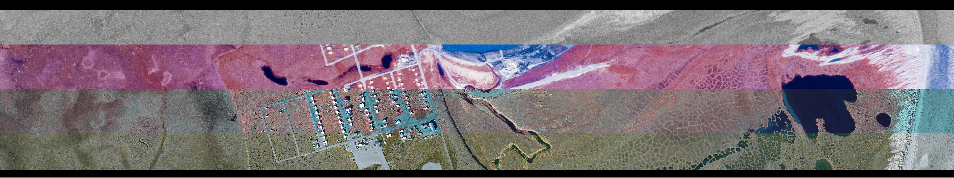
<Home Button> | QGSI ArcGIS Geo-Spatial and Satellite Imagery |  |  |  | <Text about Northern Tests Case?> | Logos?

Slide 6
Menu | Key Points | Delta Junction Mapathon Images | Mapathons | North Slope Mapathon Images? | Other info and stats | Logos?

Slide 7
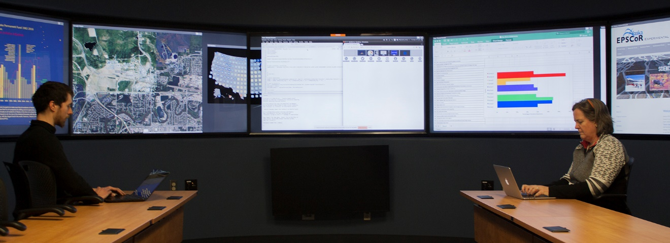
 | SAGE2 Things

Slide 8


Slide 10
 |  |  | Dev Space and VR things

